Slide 1

Mask Detection

Slide 2
Contents
Introduction
Purpose
Working
The code
Areas of application
Post covid applications
Conclusion.

Slide 3
Introduction
Can camera be used for covid-19 prevention?
of course yes!
Mask Detection’ is a technology where you will be alerted when not wearing a mask
As ‘Prevention is better than cure’

Slide 4

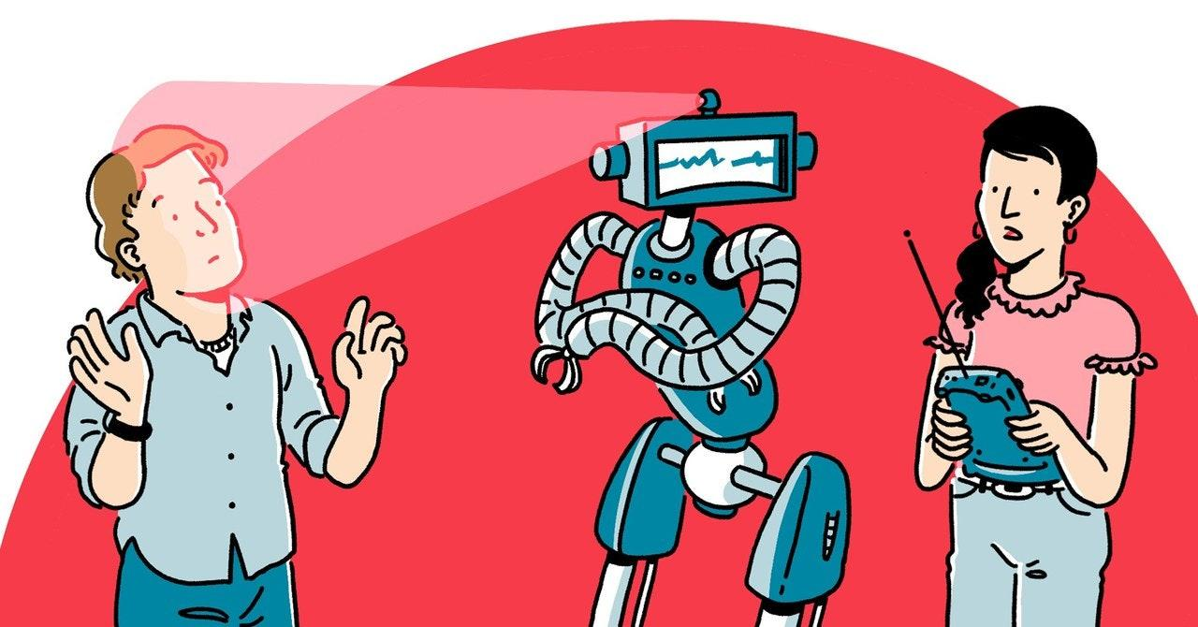
You will be more secured next time!

Slide 5
WHY WE HAVE DEVELOPED
It Will limit the spread of COVID19 or Any future pandemic in public places
Alerts people when they forget to wear a mask
Can be used post COVID 19 after upgradations

Slide 6
Working
Scanning people’s mouths
If a mouth is detected, Warning is sent
After 5 warnings, the picture of the person is sent to the authorities

Slide 7
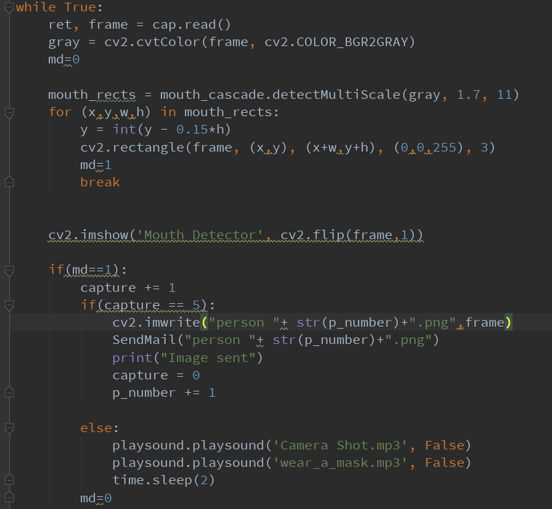

Slide 8
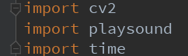
Libraries used
OpenCV
Playsound
Time

Slide 9
Areas of application
Banks
Hospitals and medical.
Hotels
Temple.
Malls and market
Schools and colleges.
MNC’s

Slide 10
Post covid applications
Mostly useful at ATM’S , Banks,etc.
Finding out missing person.

Slide 11
Pros
Searching missing person
For children at schools
Limits covid19 spread
Alerts peoples at public places
Increased security in ATM and banks

Slide 12
Conclusion
As camera nowadays is essential part of every aspect . It’s only going to become more important .
It will continue to makes individuals life more secured.
After the pandemic ends it will continue to be developed for different aspects in the future.

Slide 13


Slide 14


